Slide 1
STUDENT DATABASE MANAGEMENT SYSTEM
CIS 552: DATABASE DESIGN (Spring 2024)
Group-3 Team members –
Piyush Kolte (32)
Pawan Karthik (27)
Mythri Krpet Jayaram (35)

Slide 2

INTRODUCTION
The proposed project aims to create a student database management system within educational institutions by integrating cutting-edge database technologies.
We are Integrating cutting-edge database technologies: Jupyter Notebook (Python), MongoDB, and Neo4j
Develop a robust Student Database Management System (DBMS) with Python-based frontend using Jupyter Notebook to provide a seamless user experience.
Efficient data storage, retrieval, and management of structured and unstructured student data
Enable advanced querying, analysis, and insights into student performance, enrollment trends, and academic networks

Slide 3
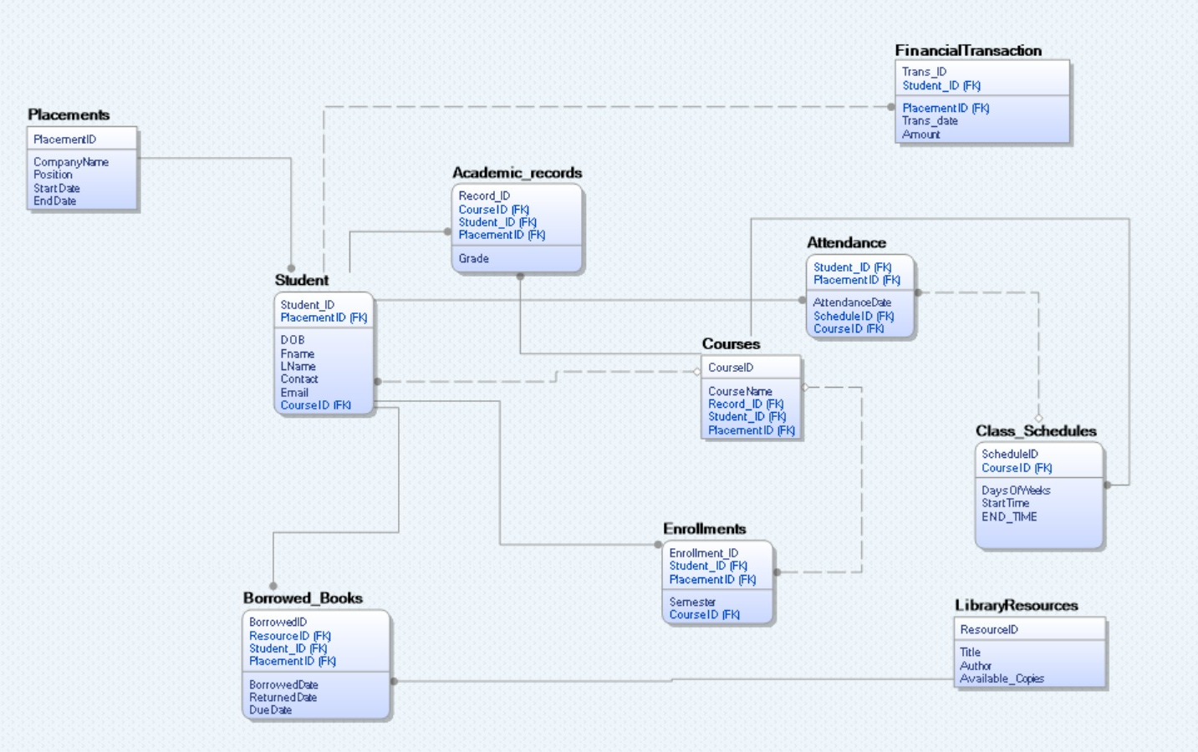
ER Diagram

Slide 4
MongoDB
We use MongoDB in the Student Database Management System for its efficient handling of diverse student data, providing flexibility in data modelling and scalability for evolving educational requirements.
MongoDB is a NoSQL database that stores data using JSON-like documents.
Key Features-
Flexible Data Model
Scalability
Flexible Deployment Options

Slide 5
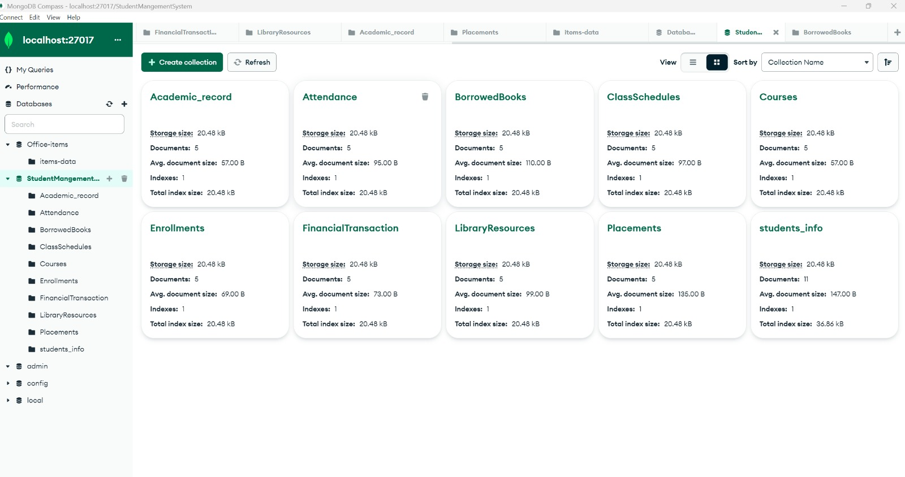
MongoDB

Slide 6
FRONT-END
We aim to create a seamless and intuitive user experience for administrators, faculty, and students by developing a Python-based frontend using Jupyter Notebook (Python)
This comprehensive method will offer efficient storage, retrieval, and manipulation of student-related data, catering to the diverse needs of educational institutions

Slide 7
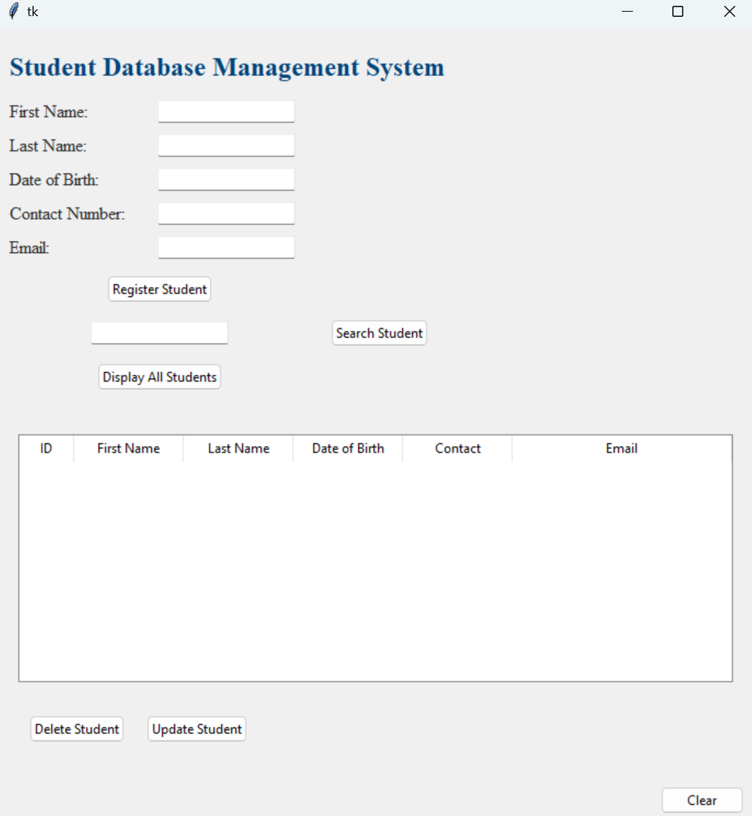
FRONT-END

Slide 8

Future Scope
Continuous Feedback Mechanisms: Collect continuous feedback to improve the system’s effectiveness in supporting the academic community.
Real-Time Analytics and Dashboards: Use Python libraries like Dash or Plotly to create real-time analytics dashboards. This can provide valuable insights into attendance, course popularity, performance trends, and resource utilization for administrators, teachers, and students.
Graph-Based Recommendations: To recommend study groups, mentors, extracurricular activities, or resources based on students’ interests, connections, and past interactions.

Slide 9
Thank You Questions??

